Slide 1
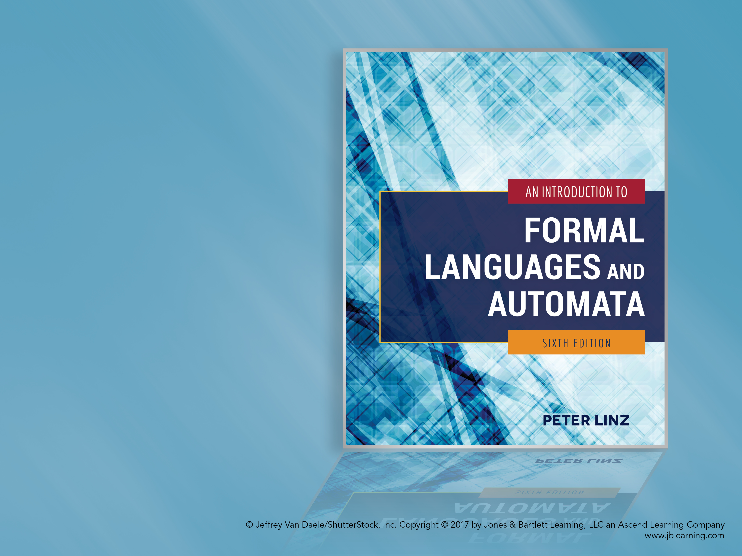
Chapter 10
OTHER MODELS OF TURING MACHINES

Slide 2

Learning Objectives At the conclusion of the chapter, the student will be able to:
Explain the concept of equivalence between classes of automata
Describe how a Turing machine with a stay-option can be simulated by a standard Turing machine
Describe how a standard Turing machine can be simulated by a machine with a semi-infinite tape
Describe how off-line and multidimensional Turing machines can be simulated by standard Turing machines
Construct two-tape Turing machines to accept simple languages
Describe the operation of nondeterministic Turing machines and their relationship to deterministic Turing machines
Describe the components of a universal Turing machine
Describe the operation of linear bounded automata and their relationship to standard Turing machines

Slide 3
Equivalence of Classes of Automata
Two automata are equivalent if they accept the same language
Given two classes of automata C₁ and C₂, if for every automaton in C₁ there is an equivalent automaton in C₂, the class C₂ is at least as powerful as C₁
If the class C₁ is at least as powerful as C₂, and the converse also holds, then the classes C₁ and C₂ are equivalent
Equivalence can be established either through a constructive proof or by simulation

Slide 4
Turing Machines with a Stay-Option
In a Turing Machine with a Stay-Option, the read-write head has the option to say in place after rewriting the cell content
Theorem 10.1 states the class of Turing machines with a stay-option is equivalent to the class of standard Turing machines
To show equivalence, we argue that any machine with a stay-option can be simulated by a standard Turing machine, since the stay-option can be accomplished by
A rule that rewrites the symbol and moves right, and
A rule that leaves the tape unchanged and moves left

Slide 5
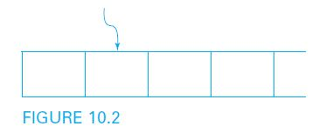
Turing Machines with Semi-Infinite Tape
As shown in Figure 10.2, a common variation of the standard Turing machine is one in which the tape is unbounded only in one direction
A Turing machine with semi-infinite tape is otherwise identical to the standard model, except that no left move is possible when the read-write head is at the tape boundary

Slide 6
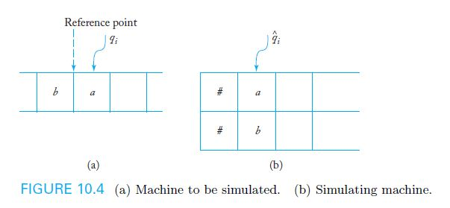
Equivalence of Standard Turing Machines and Semi-Infinite Tape Machines
The classes are equivalent because, as shown in Figure 10.4, any standard Turing machine can be simulated by a machine with a semi-infinite tape
The simulating machine has two tracks: the upper track contains the symbols to the right of an arbitrary reference point, while the lower track contains those to the left of the reference point in reverse order

Slide 7
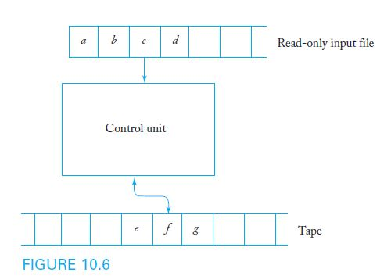
The Off-Line Turing Machine
As shown in Figure 10.6, an off-line Turing machine has a read-only input file in addition to the read-write tape
Transitions are determined by both the current input symbol and the current tape symbol

Slide 8
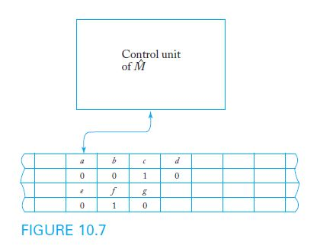
Equivalence of Standard Turing Machines and Off-Line Turing Machines
The classes are equivalent because, as shown in Figure 10.7, a standard Turing machine with four tracks can simulate the computation of an off-line machine
Two tracks are used to store the input file contents and current position, while the other two tracks store the contents and current position of the read-write tape

Slide 9
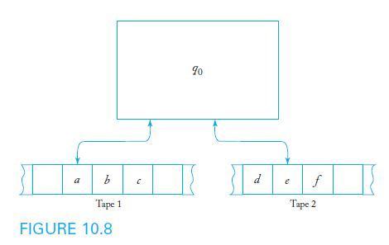
Multitape Turing Machines
As shown in Figure 10.8, a multitape Turing machine has several tapes, each with its own independent read-write head
A sample transition rule for a two-tape machine must consider the current symbols on both tapes:
δ(q₀, a, e) = (q₁, x, y, L, R)

Slide 10
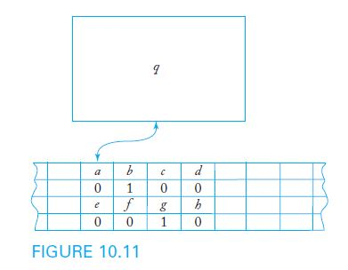
Equivalence of Standard Turing Machines and Multitape Turing Machines
The classes are equivalent because, as shown in Figure 10.11, a standard Turing machine with four tracks can simulate the computation of an off-line machine
Two tracks are used to store the contents and current position of tape 1, while the other two tracks store the contents and current position of tape 2

Slide 11
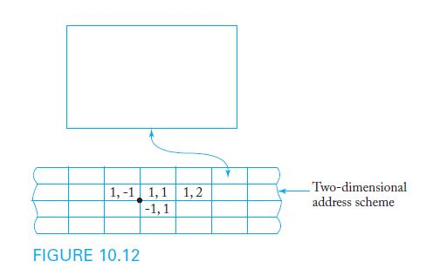
Multidimensional Turing Machines
As shown in Figure 10.12, a multidimensional Turing machine has a tape that can extend infinitely in more than one dimension
In the case of a two-dimensional machine, the transition function must specify movement along both dimensions

Slide 12
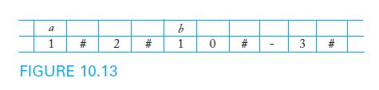
Equivalence of Standard Turing Machines and Multidimensional Turing Machines
The classes are equivalent because, as shown in Figure 10.13, a standard Turing machine with two tracks can simulate the computation of a two-dimensional machine
In the simulating machine, one track is used to store the cell contents and the other one to keep the associated address

Slide 13
Nondeterministic Turing Machines
A nondeterministic Turing machine is one with potentially many transition choices for a given ( state, symbol ) combination
Example 10.2 presents a sample transition rule for a nondeterministic machine:
δ(q₀, a) = {(q₁, b, R), (q₂, c, L)}
Since multiple transitions may be applied at each step, the machine may have multiple active simultaneous threads, any of which may accept the input string when the thread halts
For every nondeterministic Turing machine, there is an equivalent deterministic machine that can simulate its operation

Slide 14
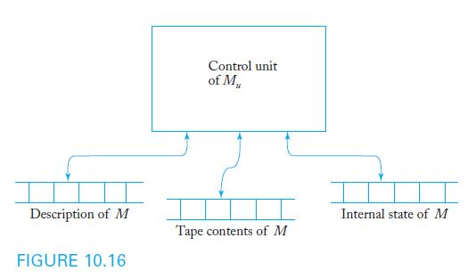
A Universal Turing Machine
A universal Turing machine is a reprogrammable Turing machine which, given as input the description of a Turing machine M and a string w, can simulate the computation of M on w
A universal Turing machine has the structure of a multitape machine, as shown in Figure 10.16

Slide 15
Linear Bounded Automata
The power of a standard Turing machine can be restricted by limiting the area of the tape that can be used
A linear bounded automaton is a Turing machine that restricts the usable part of the tape to exactly the cells used by the input
Input can be considered as bracketed by two special symbols or markers which can be neither overwritten nor skipped by the read-write head
Linear bounded automata are assumed to be nondeterministic and accept languages in the same manner as other Turing machine accepters

Slide 16
Languages Accepted by Linear Bounded Automata
It can be shown that any context-free language can be accepted by a linear bounded automaton
In addition, linear bounded automata can be designed to accept languages which are not context-free, such as
L = { a^{n}b^{n}c^{n}: n ≥ 1 }
While it is difficult to come up with a concrete and explicitly defined language to use as an example, linear bounded automata are not as powerful as standard Turing machines

